Slide 1
Anatomy of a Software House
Continued

Slide 2
Producing the Budget
Staff in the company are divided into two categories
Technical or revenue earning staff
Non-revenue earning staff
Both require different capital to work.

Slide 3
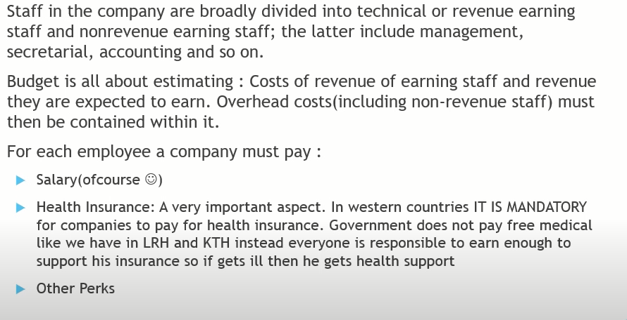
Producing the Budget

Slide 4
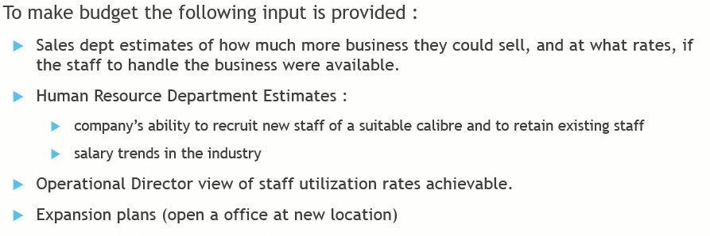
Producing the Budget

Slide 5
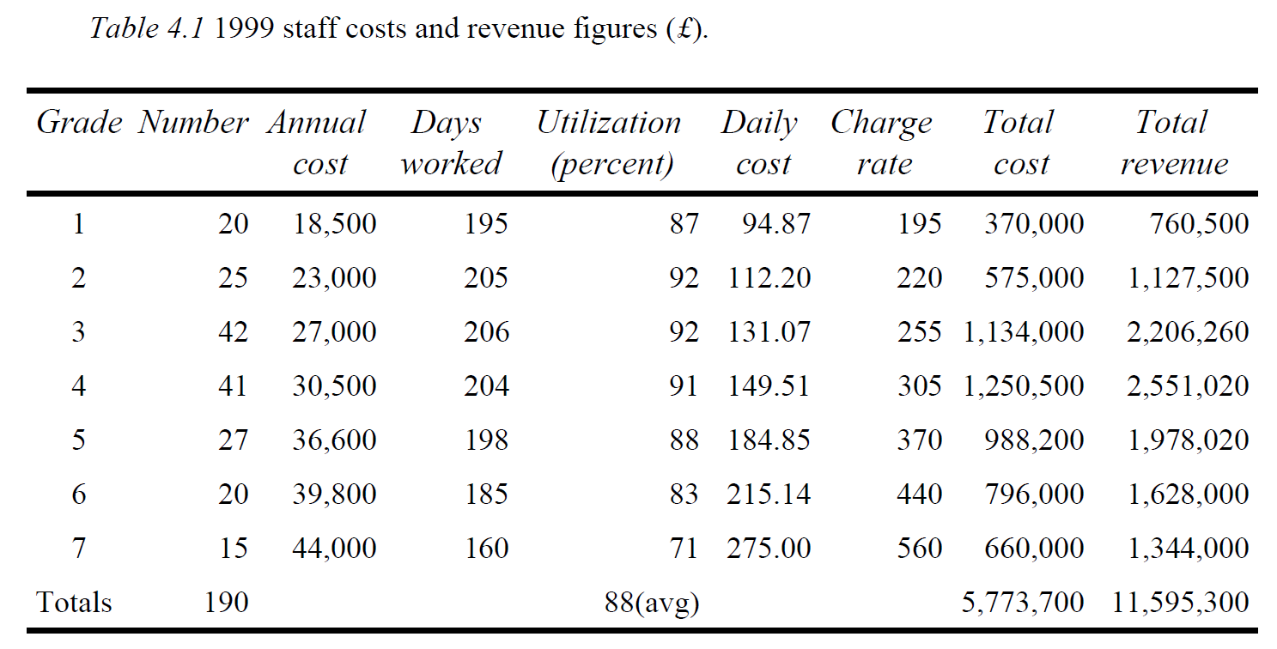

Slide 6
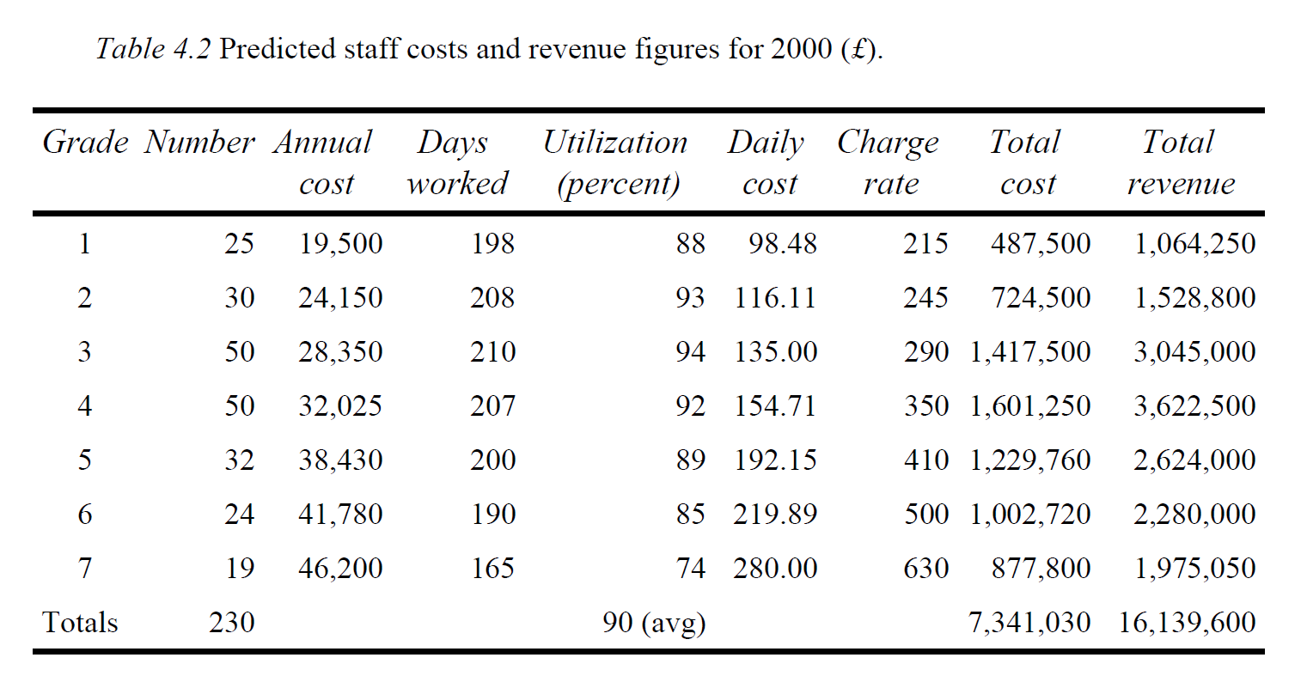

Slide 7
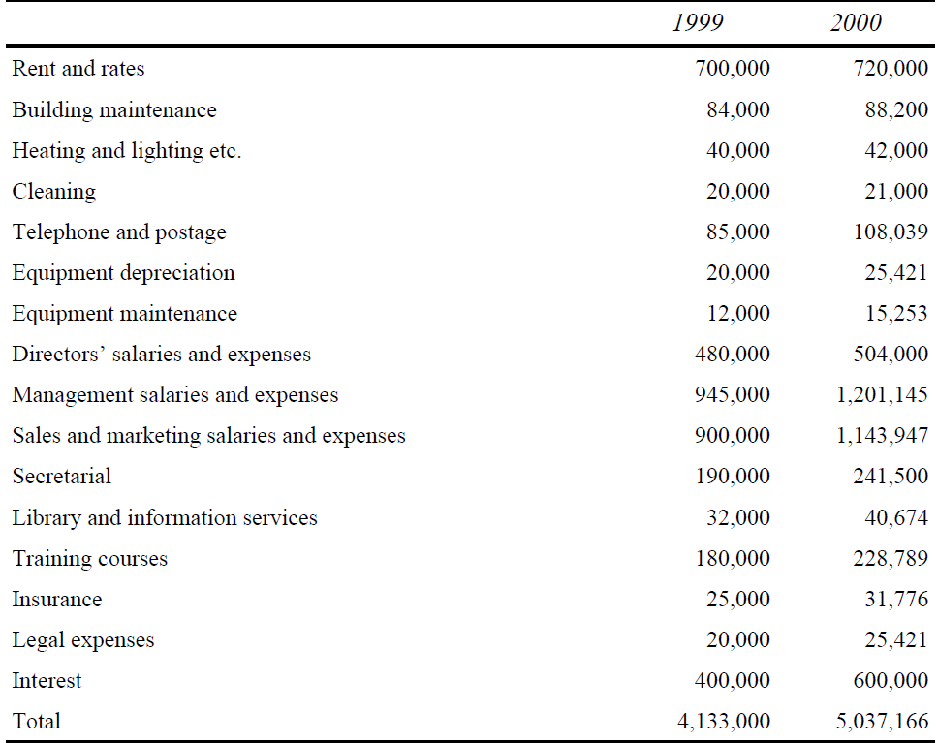
Producing the Budget

Slide 8
Monitoring Financial Performance
Monitoring Syniad’s performance against the budget should, in principle, be straightforward. Each month, the income and expenditure under the various heads are compared and, if significant deviations are observed, corrective action is taken. In practice, this simple procedure presents many difficulties.
Cost and revenue
Project costing
Sales

Slide 9
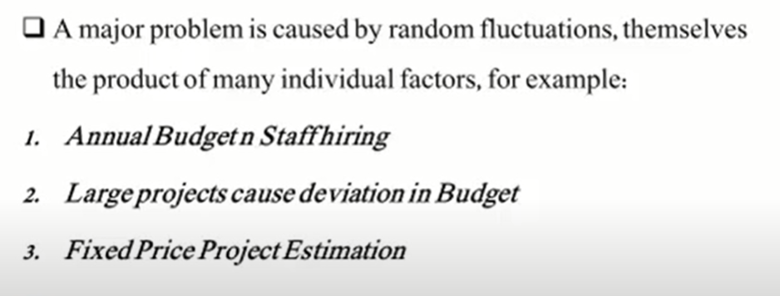
Costs and Revenue

Slide 10
Project Costing
Because of these difficulties in monitoring the overall performance of the company, Syniad also tries to monitor the financial performance of individual projects, through a project costing system.
The costs and revenue of each project are calculated each month and the cumulative gross margin (i.e. the difference between total costs and total revenue to date on the project) calculated as a percentage of the total revenue
Project managers complain that there is very little they can do about the costs.

Slide 11
Sales
Two reports are used for assessing and monitoring the sales position.
confirmed sales report
sales prospects report

Slide 12
Sales
The confirmed sales report shows, for each grade, the number of staff in that grade who are committed to contracts in each of the following twelve months and the total expected revenue from that grade in each month.
The sales prospects report shows, for each sales prospect, the potential value of the sale, its likelihood and the likely start date.

Slide 13
Long Term Planning
Strategic Planning for future
The ability to plan strategically and to achieve strategic objectives
Strategic planning in Syniad has two related aspects
The first is to identify appropriate long-term goals
To identify and formulate plans to overcome those problems which are inhibiting it from attaining these goals

Slide 14
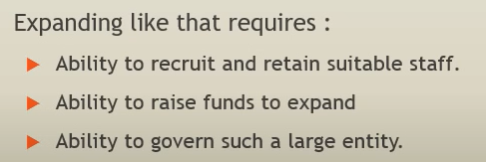
Long Term Planning
Expansion plans
Recruit sales and management staff locally
Company image
Product mix(fee based revenue vs package software)
Finance(under capitalization)

Slide 15
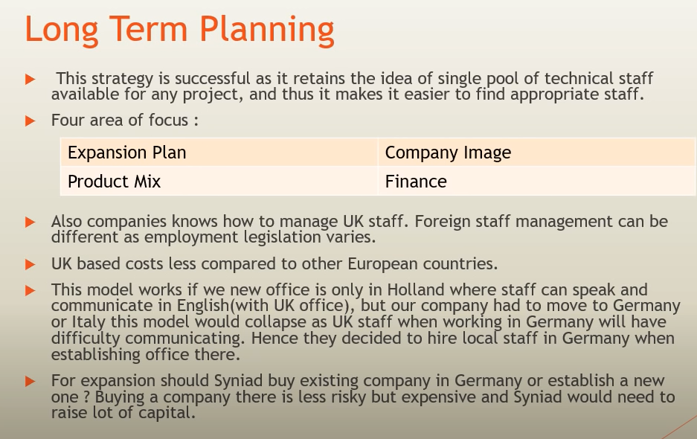

Slide 16
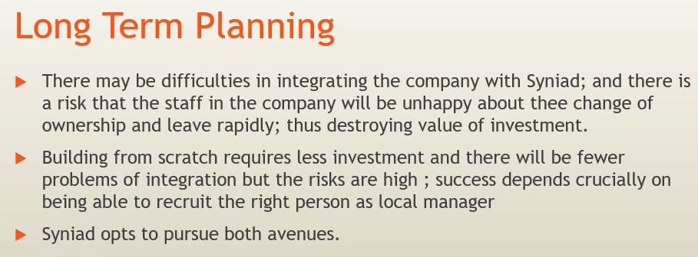

Slide 17
Conclusion
Syniad, despite its problems, is a successful and well-managed company. However, they need to go multi national
Do directors have the expertise to manage this transition or to run the resulting company?
However, it seems probable that Syniad has now reached a point where it can no longer thrive as a private company and its future must, inevitably, be very different from its past

